Slide 1

TWO FACTOR LOCK FOR VISUALLY DISABLED
CPG No. 23
KHUSHI GOEL (102017112)
AYUSH NAGPURE (102016100)
ASMI LAKHANI (102016041)
NIMIT GUPTA (102016056)
NITISH KUMAR (102196010)

Slide 2
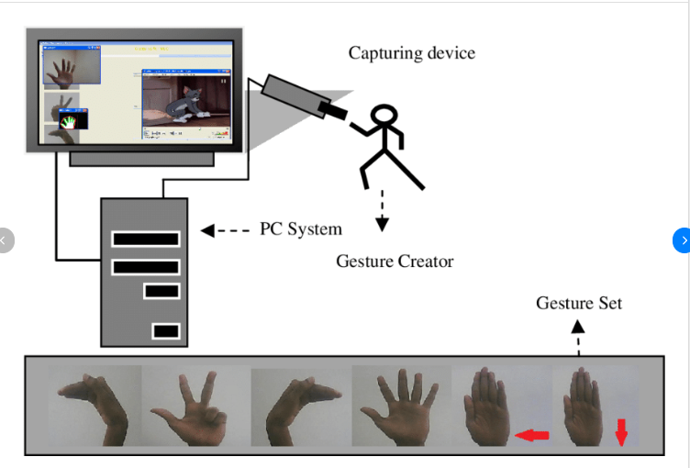
Project Overview
Visually impaired people face limitations to carry out movements and their daily activities without assistance.
This project aims to build a two-factor secure lock that can be used independently by visually disabled people without any assistance.
It will first use face detection and then hand gestures to unlock the door.This lock ensures safety and convenience.
They can check and control who is at the door. This helps them to move freely in the house without any fear that someone can enter without their knowledge or permission.

Slide 3
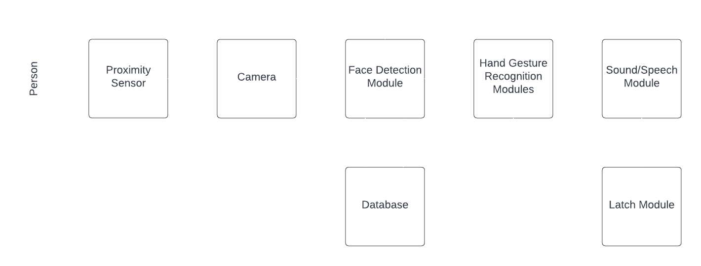
BLOCK DIAGRAM

Slide 4
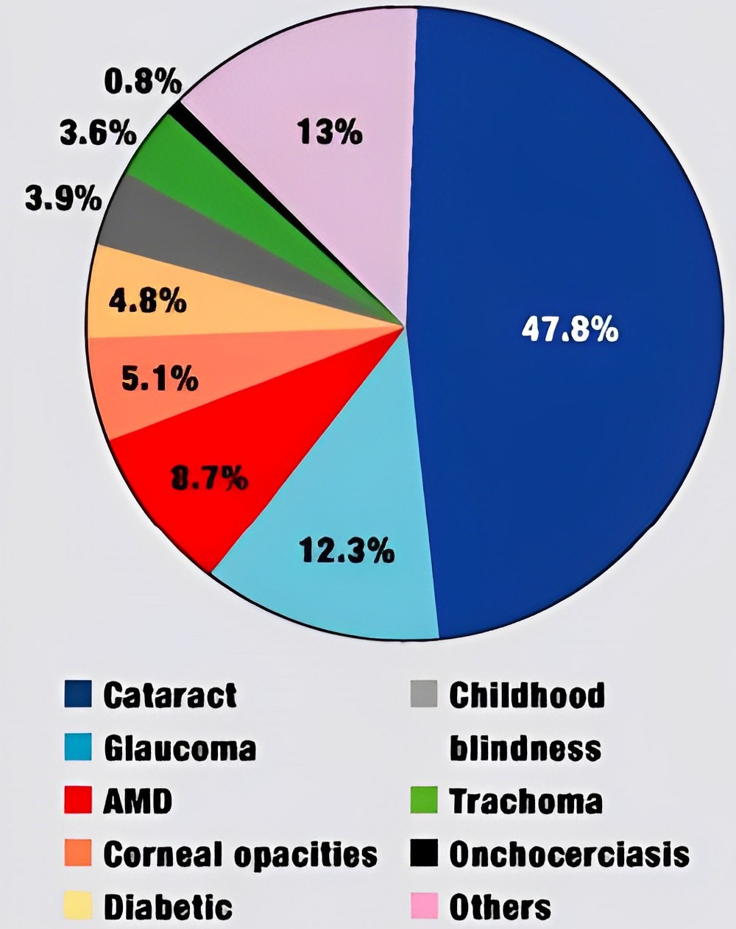
Need Analysis
Visually impaired individuals face difficulties in recognizing known individuals without audio or haptic cues, which limits their social interactions and poses security risks.
Several prototype systems have been developed to aid visually impaired individuals with face recognition, but special considerations are required to make these systems usable for them.
There is a need to develop a lock that can be used independently by visually impaired individuals as current locking systems available in the market cannot be used independently by them and may not be very secure.

Slide 5
Literature Survey
A report by the World Health Organization (WHO) and International Agency for Prevention of Blindness (IAPB) stated that there are approximately 285 million people around the world who are visually impaired. Moreover, almost 90% of them have to depend on others to ensure their safety.
Some of the existing solutions are SWING DOOR LOCK and YALE ENTR SMART DOOR LOCK.
S. No | Author | Paper Title | Tools/Technology | Findings
1 | Nitesh Saxena and James H. Watt | Authentication Technologies for the Blind or Visually Impaired. | Computer Vision | Usable Security research aimed at disabled user population becomes extremely challenging is that disabled human subjects are not easily accessible to perform usability studies.
2 | Khan et. al. | Secure biometric template generation for multi-factor authentication | Image Processing, Biometric sensors. | It involves using a secure sketch-based approach to generate a binary template from the original biometric data. The binary template is then hashed using a secret key to create a secure and encrypted version.

Slide 6
3 | Yugashini et. al. | Design and Implementation of Automated Door Accessing System with Face Recognition | Computer Vision, GSM module | Facial recognition gives good results and is highly secure as the face is matched with database, alerting users via SMS.
4 | Shah et. al. | Biometric Voice Recognition in Security System | Signal processing | The system successfully recognizes the user’s voice, by feature extraction and comparing it with that stored in the database, instructing Arduino to open the door, and rejects all the other impostor’s voices.
5 | Daniella Briotto Faustino and Audrey Girouard | Understanding Authentication Method Use on Mobile Devices by People with Vision Impairment | Computer Vision,Image Processing | It showed that majority consider fingerprints to be the most secure and most accessible user authentication methods.Survey showed that blind people considered patterns the least accessible methods.

Slide 7
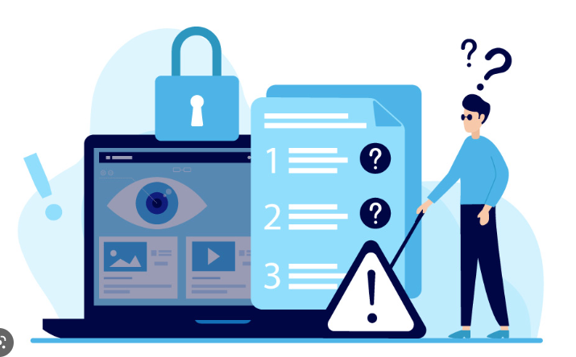
Problem Statement
Objectives:
The conventional lock and key method cannot be used by a visually disabled person. Also, there exist other automated systems like the fingerprint scanner, retina scan but all of these are not very useful for such people.These systems are not very secure so a locking system is needed which is both secure and convenient to use.
The proposed system seeks to meet the following goals:
To study about the problems and the needs associated with the visually impaired people.
To develop a 2-factor authentication lock using 2 modules - face recognition and hand gesture recognition.
To minimize the effect of background on face recognition and hand gesture recognition algorithms so that accuracy can be increased.

Slide 8
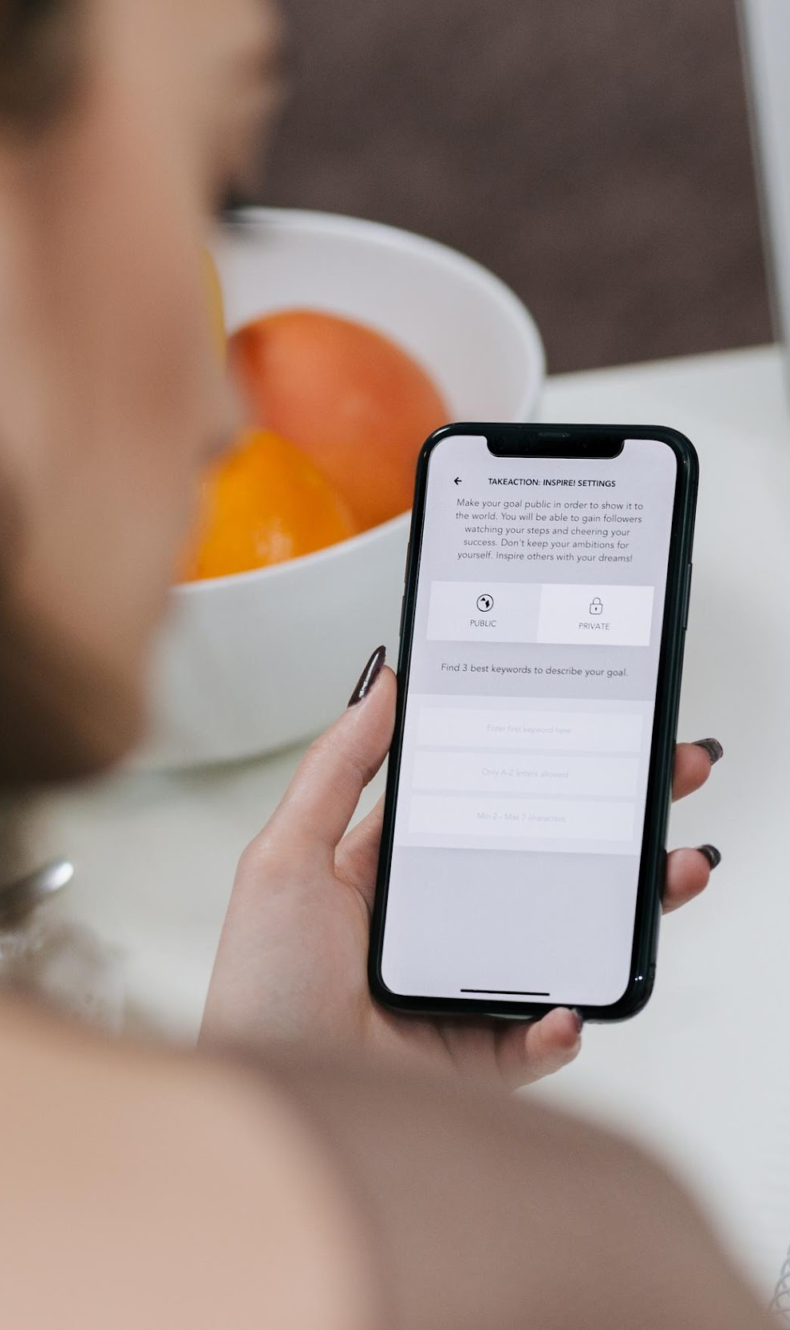
METHODOLOGY
The following steps are followed while working on the proposed system:
A proximity sensor → to detect the presence of a person in front of the lock.
Face recognition module developed consists of a database of allowed faces with the blind person being the master user with the ability to enter the gesture lock. Local storage or AWS S3 bucket shall be used to maintain the database.
A hand gesture recognition module will be developed to store a passkey corresponding to the sequence of hand gestures as demonstrated by the master user. The passkey can be changed only by the master user.
The latch module upon receiving the trigger signal will open the latch for 10s when the gesture matches and closes automatically after the person enters the facility. Else if the category of the user is known then sound module will be activated,which would announce the name of the person at the door.
The following framework will be followed:
Front End (Graphical User Interface)
Back End(using Python)
Database(AWS S3 bucket)
Model Building(Python libraries likely, Tensorflow and Keras)
Deployment(AWS using EC2 instances)

Slide 9
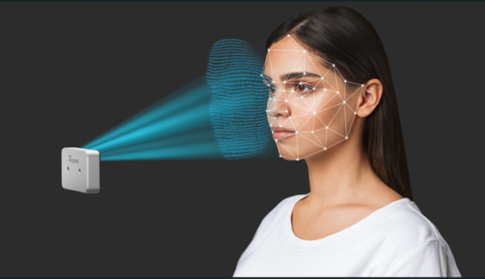
Assumptions and Constraints
ASSUMPTIONS
It is assumed that the visually impaired user can navigate through the main door and house.
It is assumed that the user has learned the hand gestures for the passcode.
It is assumed that the user has sufficient hearing ability to listen to the voice output by the locking system and react accordingly.
It is assumed that lighting is adequate for efficient image pre-processing.
It is assumed that the ML model will have high accuracy and very little time delay.
CONSTRAINTS
The gesture sequence can be mimicked by another person standing beside the blind user.
Synchronization of dynamic gestures posed by the blind user with the camera frame rate is a challenge.

Slide 10
Project Requirements
Tools and Technologies Used
Hardware
1. OpenCV: Python library of programming functions mainly aimed at real-time computer vision
2. Tensorflow, Keras: Python libraries for deep learning model implementation
3. AWS EC2 instance for processing
4. AWS S3 bucket: A public cloud storage resource available in Amazon Web Services' Simple Storage Service, for the database.
5. Languages: Python, C++
Raspberry Pi 4
Raspi Camera
Electric Latch
AC DC power Supply Module
1 Channel 5V Relay Module
RF Relay
Breadboard
Buzzer
Proximity Sensor

Slide 11
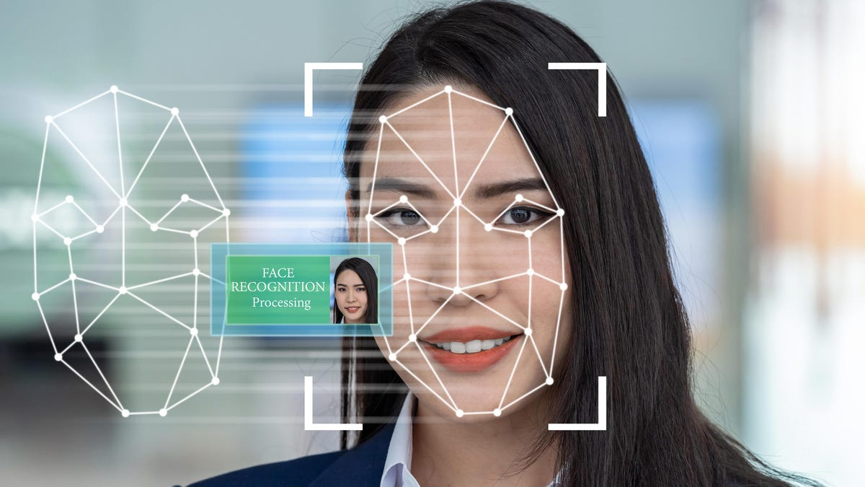

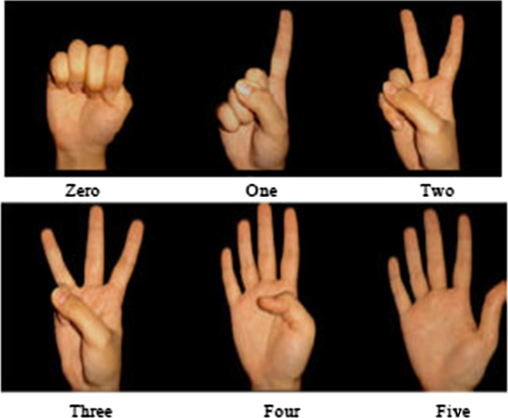
Project Outcome
The major outcome of our project will be a two-factor lock which will be easy and convenient to use as well as safe for visually disabled people.
This well authenticated secure locking system will use two modules-face recognition and hand gesture recognition.Upon accurate hand gesture and pattern recognition, the lock will be triggered and will accordingly be unlocked.

Slide 12
Sr. No. | Activity | Month | Feb Apr |  | May-Jun |  |  |  | Jul-Aug |  |  |  | Sep-Oct |  |  |  | Nov-Dec
 |  |  | 1 | 2 | 3 | 4 | 5 | 6 | 7 | 8 | 9 | 10 | 11 | 12 | 13 | 14 | 15 | 16 | 17 | 18
1 | Project planning and study of hardware, software requirements | Plan
 |  | Actual
2 | Face recognition module development | Plan
 |  | Actual
3 | Gesture module development | Plan
 |  | Actual
4 | Design Optimisation and Modifications | Plan
 |  | Actual
5 | Circuit designing ,Raspberry Pi code | Plan
 |  | Actual
6 | Integration between hardware and web services | Plan
 |  | Actual
7 | Testing and Modification | Plan
 |  | Actual
8 | Final Report | Plan
 |  | Actual

Slide 13
Individual Roles
S.No | Task | Individuals involved
1. | Circuit Design | Nitish Kumar, Khushi Goel
2. | Raspberry Pi Code | Ayush Nagpure, Khushi Goel
3. | Face Detection Module | Nimit Gupta, Nitish Kumar
4. | Hand gesture Module | Asmi Lakhani, Nitish Kumar
5. | Latch Module | Asmi Lakhani, Nimit Gupta
6. | Voice Triggering | Ayush Nagpure
7. | Integration b/w hardware and web services | Ayush Nagpure, Nimit Gupta
8. | Documentation | Khushi Goel, Asmi Lakhani

Slide 14
References
[1] Homecrux (2017). Swing Door Lock comes with blind-friendly mechanism – homecrux.com [Online]. Available: https:// www. homecrux.com/swing-door-lock- comes-blind-friendly-mechanism/61902/ [2] Yale smart Living (2016). ENTR Smart Door Lock [Online]. Available: https://www.yalelock.it/en/ yale/yale-italy/smart-living/ smart-door-locks/
[3] Nitesh Saxena and James H. Watt “Authentication Technologies for the Blind or Visually Impaired”, 2010.
[4] Salman H. Khan, M. Ali Akbar, Farrukh Shahzad, Mudassar Farooq, Zeashan Khan, “Secure biometric template generation for multi-factor authentication”, Volume 48, Issue-2, pp. 458-472, February 2015.
[5] H.N. Mohd. Shah, Mohd. Z.A Rashid, Mohd. F. Abdollah, M.N. Kamarudin, C.K. Lin, Z. Kamis, “Biometric Voice Recognition in Security System”, Indian Journal of Science and Technology(IJST), Volume. 7(2), pp. 104–112, February 2014.
[6] Daniella Briotto Faustino and Audrey Girouard, “Understanding Authentication Method Use on Mobile Devices by People with Vision Impairment”, the 20th International ACM SIGACCESS Conference, pp. 217–228, October 2018.
[7]Daniella Briotto Faustino and Audrey Girouard, “Understanding Authentication Method Use on Mobile Devices by People with Vision Impairment”, the 20th International ACM SIGACCESS Conference, pp. 217–228, October 2018.

Slide 15


